Slide 1


Slide 2
ERASMUS +
Traineeship
CHECKLIST
BEFORE DEPARTURE
WHAT SHALL I DO NOW?
International Mobility Unit – July 2026

Slide 3
WHAT’S ON THE AGENDA TODAY…
      Before departure
Checking entry rules: Visa?
Learning Agreement - International Mobility Coordinators
Mobility Agreement
Financial contributions
Bank details
OLS Test

Slide 4
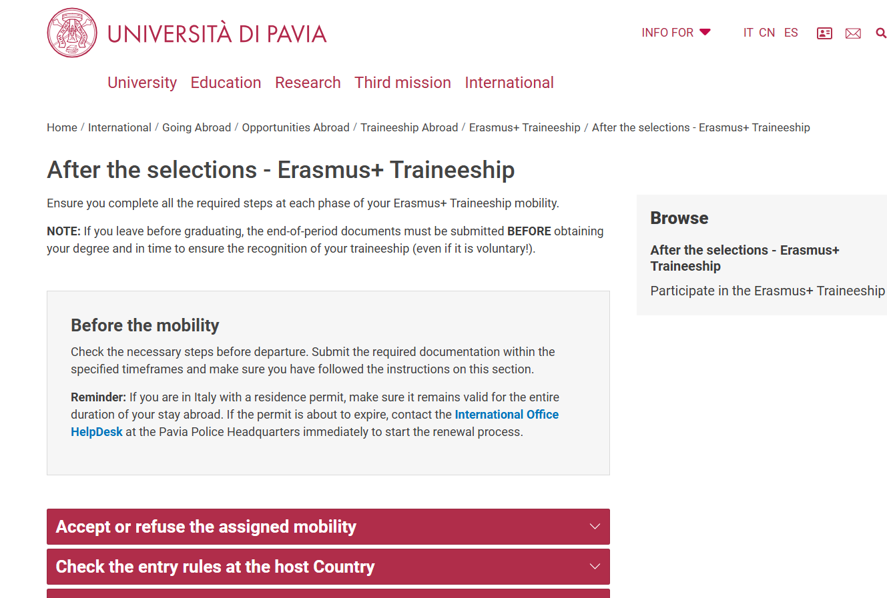
CHECK OUR WEBSITE!!

Slide 5
VISA and ENTRY RULES
Inform yourself about entry rules and healthcare assistance
in the host country.
You can rely on:
Host Country Embassy
Host University instructions
https://www.esteri.it/it/
https://www.viaggiaresicuri.it/home
What UniPV can provide:
Certificate of Assignment
Unipv insurance policies (Accident, Civil Liability)
NO HEALTH INSURANCE!!

Slide 6

RESIDENCE PERMIT
If you are in Italy with a residence permit, make sure it remains valid for the entire period of mobility abroad. If you need to renew it, take action and start the renewal process as earliest as possible. If you need assistance, contact the dedicated
office: HelpDesk Permit of Stay

Slide 7

ACCOMMODATION
Seek information from the host Institution:
on-campus housing / students' residence or a list of accommodations
Contact the local ESN section
If you are looking for accommodation independently, be careful about making
prepayments. Do not accept too high deposits or pay by traceable methods.

Slide 8
LEARNING AGREEMENT
The LA sets out the progamme of the activities to be followed abroad.
Before departure:
Download the Learning Agreement form from our website
Fill in the LA together with your host supervisor and your Unipv Coordinator to agree on the Learning Agreement content.
Send the duly signed LA to the International Mobility Office (outgoing.mobility@unipv.it)
Mandatory details:
Data of the Trainee
Data of the International Mobility Coordinator
Data of the host supervisor
Mobility period: START and END
Programme/Activity of the traineeship (e.g. what the acceptance letter outlines)
CREDITS: curricular internship!
Signatures

Slide 9
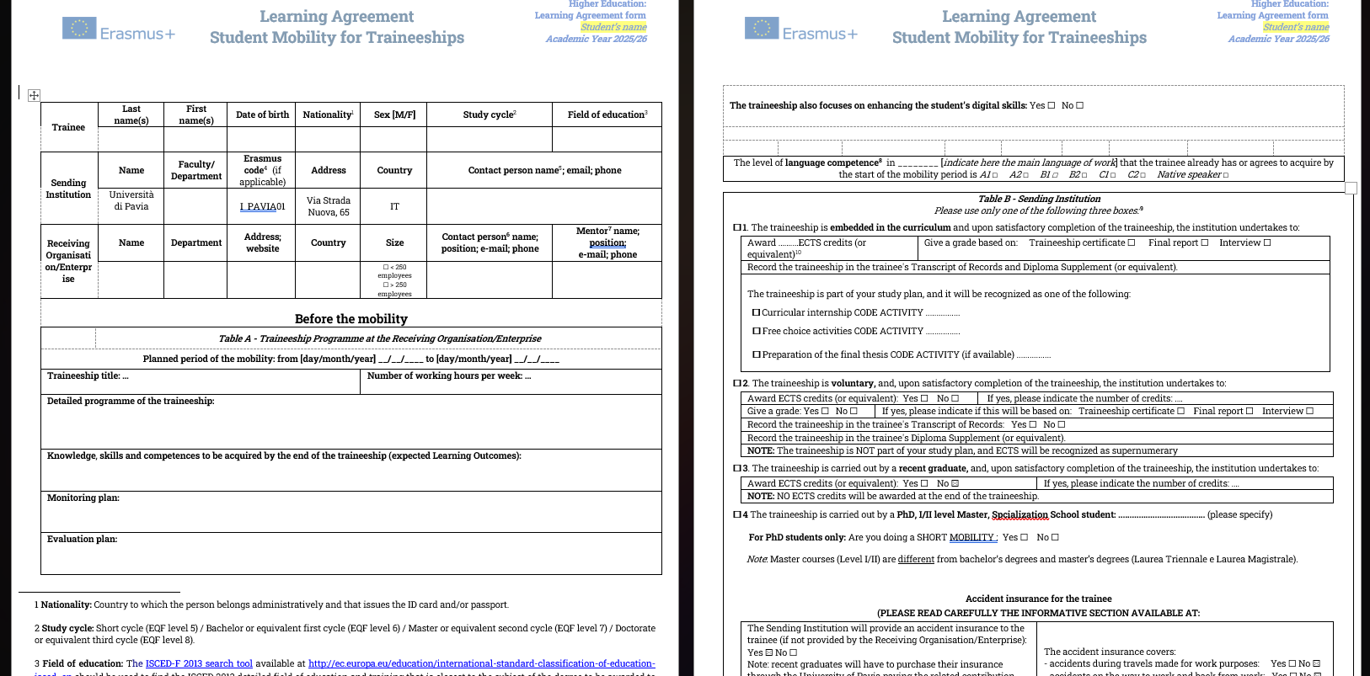
Your data
Your international mobility coordinator
MANDATORY
Host supervisor
Max. 40

Slide 10
LEARNING AGREEMENT: Table B
Select point 1 > if you leave before graduating and the traineeship is part of your study plan (code):
number of credits is COMPULSORY
point 3 > if you leave after graduating: NO credits recognition
point 2 > if you leave before graduating and the traineeship is NOT part of your study plan:
number of credits is COMPULSORY but supernumerary >> NO FELLOWSHIP!!
point 4 > only for post-graduates (PhD’s, Specialization Schools, Master Courses*)
* 1st or 2nd level master course: NOT Master’s degree
If you have doubt about curricular / volountary traineeship: please contact
your secretary or your Coordinator!

Slide 11
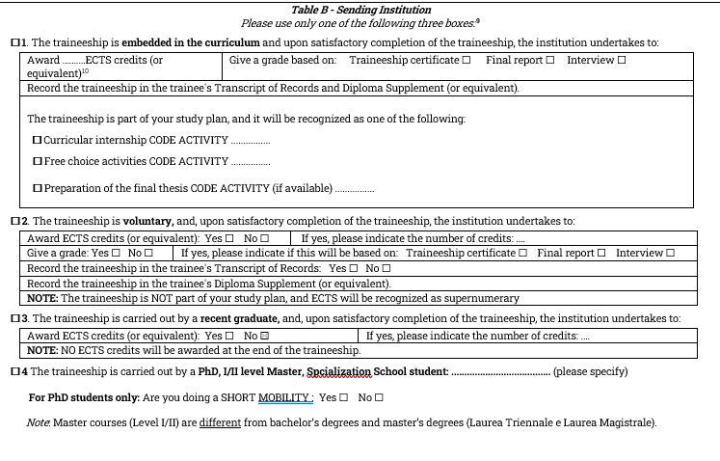
LEARNING AGREEMENT: Table B
x

Slide 12
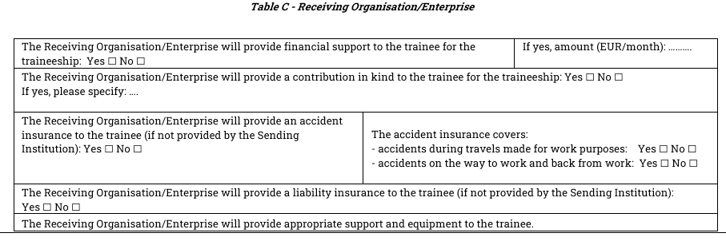
LEARNING AGREEMENT: Table C
You can receive financial support from the Receiving Organisation/Enterprise, unless it comes from EU Funding (i.e. SEMP programme for CH)

Slide 13
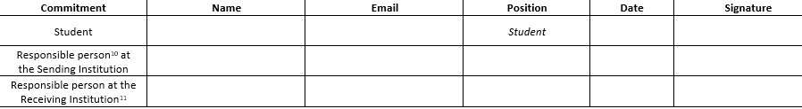
LEARNING AGREEMENT: signatures
IMPORTANT: the Learning Agreement MUST be signed by you, the host Institution and the UniPV International Mobility Coordinator
Recommended submission deadline: a month and a half before departure!
Where is the form: Internazionale --> Erasmus Traineeship --> Dopo le selezioni --> prima di partire
All signatures are MANDATORY before departure

Slide 14
INTERNATIONAL MOBILITY COORDINATOR – ERASMUS COORDINATOR
List of the Coordinators
Supports students in drafting the Learning Agreement
Responsible for the approval of traineeship plan of the Learning Agreement before departure (and the credits/recognition CODE)
Approves changes to the LA during mobility (if any)
Responsible for the academic recognition of the results achieved abroad by the student upon return
Notes:
Still waiting for the full list of the mobility representatives.

Slide 15
IF YOU LEAVE AFTER GRADUATING:
You’re not required to indicate the credits in the learning agreement
Still required to submit the Upon return documents:
Traineeship Certificate and Final report
You are required to pay the Integrative Insurance Policy. Instructions on the website.
Insurance Policies – valid only at the «workplace»:
  CIVIL LIABILITY
  ACCIDENT

Slide 16
MOBILITY AGREEMENT
It can only be set before departure,
If you have already sent the approved Learning Agreement
Notes:
Terms pf payment

Slide 17
MOBILITY AGREEMENT
Last step before the mobility: sign the Mobility Agreement
Document that regulates the rights/duties of the parties and the allocation of financial contributions.
Sent to you via email before departure.
Sent in chronological order (based on the start date),
Notes:
Terms pf payment

Slide 18
MOBILITY AGREEMENT: PAYMENTS
First installment: 80% of the fellowship amount + travel - paid at the beginning of the mobility period if:
the Learning Agreement and Mobility Agreement have been signed
the fees for the academic year 26/27 have been paid
the bank account details have been entered on Esse 3 or the correct form sent by email (only for foreign bank acc.)
Notes:
Terms pf payment

Slide 19
MOBILITY AGREEMENT: PAYMENTS
Second installment: 20% of the total amount - paid upon return if:
the end of mobility documents have been sent.
recalculated on the actual dates stated on the Traineeship certificate.
NOTE: Request of prolongations during the mobility are not covered by the fellowship
Notes:
Terms pf payment

Slide 20
MOBILITY AGREEMENT
The university has a single payment deadline at the end of each month, but the necessary information are provided to the payment office at the beginning of it.
Therefore, the first installment of the scholarship can only be paid if all the steps are completed at least 1,5 months before departure.
NOTE: The accounting department will operate on a reduced schedule in August; payments are likely to be delayed to end of September
Notes:
Terms pf payment

Slide 21
BANK DETAILS
Enter the bank details of your Italian current account in your Area riservata.
Path: Home>Personal Information>Enter/Modify refund data
If you have a foreign bank account: send the appropriate form to: outgoing.mobility@unipv.it
NB: you must be the account holder or the joint account holder!!

Slide 22
GOING TO SWITZERLAND?
Swiss European Mobility Programme - SEMP
The Swiss programme provides a scholarship
SEMP scholarship is NOT compatible with the Erasmus grant
Fill out the Self declaration on «Before the Mobility» section

Slide 23
FINANCIAL CONTRIBUTIONS
Monthly contribution based on the Country of destination
MONTHLY GRANT | DESTINATION COUNTRY: PROGRAMME COUNTRY > EU MEMBER STATES + *
550 | Austria, Belgium, Denmark, Finland, France, Germany, Ireland, Iceland, Luxembourg, Liechtenstein, Norway, Netherlands, Sweden *Partner Countries: Andorra, Monaco, Fær Øer Islands, UK and Switzerland
500 | Cyprus, Estonia, Greece, Latvia, Malta, Portugal, Spain, Czech Republic, Slovakia, Slovenia. Bulgaria, Croatia, North Macedonia, Lithuania, Poland, Romania, Serbia, Hungary, Turkey
MONTHLY GRANT | DESTINATION COUNTRY: PARTNER COUNTRY > EXTRA EU
700 | Partner Countries of Regions 1 to 12 – see list at ART.3 of the Call NO MORE THAN 20% OF THE TOTAL AVAILABLE BUDGET.
+ 250 / MONTH for FEWER OPPORTUNITIES STUDENTS
Criteria available at Annex I (Article 6) of the Call, published on our website.
Notes:
Gli iscritti a scuole di specializzazione e assegnatari di borsa di specialità potranno beneficiare del contributo comunitario (salvo eventuali casistiche di incompatibilità da verificarsi puntualmente con la U.O.C. Mobilità Internazionale e la U.O.C. Scuole di Specializzazione di Area Sanitaria).
La fruizione del contributo Erasmus è incompatibile con altri fondi comunitari. Le borse di mobilità Erasmus non sono pertanto cumulabili con altri finanziamenti Europei, tra i quali borse PNRR, PON e altri contributi comunitari (fondi su cui, ad esempio, spesso gravano alcune borse di dottorato). I vincitori potranno comunque partecipare al programma rinunciando a tale contributo.

Slide 24
FINANCIAL CONTRIBUTIONS
Monthly contribution based on the Country of destination
FROM 4 MONTHS
TO 6 MONTHS MAX
Students who, at the time of application, indicated a mobility period lasting between 2 and 5 months may request an extension of their mobility and receive the Erasmus+ grant until the maximum total duration of 6 months is reached.
Notes:
Gli iscritti a scuole di specializzazione e assegnatari di borsa di specialità potranno beneficiare del contributo comunitario (salvo eventuali casistiche di incompatibilità da verificarsi puntualmente con la U.O.C. Mobilità Internazionale e la U.O.C. Scuole di Specializzazione di Area Sanitaria).
La fruizione del contributo Erasmus è incompatibile con altri fondi comunitari. Le borse di mobilità Erasmus non sono pertanto cumulabili con altri finanziamenti Europei, tra i quali borse PNRR, PON e altri contributi comunitari (fondi su cui, ad esempio, spesso gravano alcune borse di dottorato). I vincitori potranno comunque partecipare al programma rinunciando a tale contributo.

Slide 25
FINANCIAL CONTRIBUTIONS
Monthly contribution based on the Country of destination: SHORT MOBILITIES
Only FOR Ph.D STUDENTS and SPECIALIZATION STUDENTS
Notes:
Gli iscritti a scuole di specializzazione e assegnatari di borsa di specialità potranno beneficiare del contributo comunitario (salvo eventuali casistiche di incompatibilità da verificarsi puntualmente con la U.O.C. Mobilità Internazionale e la U.O.C. Scuole di Specializzazione di Area Sanitaria).
La fruizione del contributo Erasmus è incompatibile con altri fondi comunitari. Le borse di mobilità Erasmus non sono pertanto cumulabili con altri finanziamenti Europei, tra i quali borse PNRR, PON e altri contributi comunitari (fondi su cui, ad esempio, spesso gravano alcune borse di dottorato). I vincitori potranno comunque partecipare al programma rinunciando a tale contributo.

Slide 26
FINANCIAL CONTRIBUTIONS: ITEM D - UE
TRAVEL CONTRIBUTIONS | AMOUNTS
DAILY ALLOWANCE | Monthly grant / 30 days = about 15-20 Euro/day Max. 2 days for non-green travel Max. 6 days for green travel TRAVEL DAYS ARE NOT PART OF THE PERIODO INDICATED IN THE TRAINEESHIP CERTIFICATE
TRAVEL GRANT | LUMP SUM BASED ON TRAVEL DISTANCES > European Commission's distance calculator ONLY 1 TRIP
Notes:
Rimborso non più per viaggi con mezzi sostenibili.
Rimborso solo per la diaria e fino a un massimo di 6 giorni di viaggio solo per mobilità di lunga durata. No rimborso spese di viaggio.
Diaria: borsa giornaliera / 30

Slide 27
FINANCIAL CONTRIBUTION – TRAVEL
Flat rate based on the km distance. No need to send travel tickets
The Distance calculator is provided by the European Commission
> Distance between Pavia and the location of the host instituion.

Slide 28
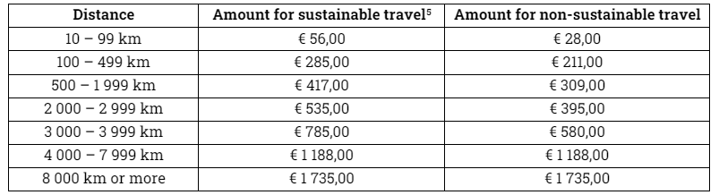
FINANCIAL CONTRIBUTION - TRAVEL GRANT
Green travel / sustainable travel: main part of the trip done by GREEN means of transport (train, bus). You are required to provide tickets or proof of travel for one journey only (to or from)
Notes:
Rimborso non più per viaggi con mezzi sostenibili.
Rimborso solo per la diaria e fino a un massimo di 6 giorni di viaggio solo per mobilità di lunga durata. No rimborso spese di viaggio.
Diaria: borsa giornaliera / 30

Slide 29
FINANCIAL CONTRIBUTIONS based on ISEE
ISEE CONTRIBUTION: Monthly contribution based on personal financial situation (ISEE), is currently NOT available and can only be awarded after the University of Pavia has received the funds from the Ministry of University and Research (MUR).
Moreover, the contribution amounts published in Annex I of the Call are INDICATIVE. The amounts may be adjusted based on any new ministerial or university regulations.
Notes:
Gli iscritti a scuole di specializzazione e assegnatari di borsa di specialità potranno beneficiare del contributo comunitario (salvo eventuali casistiche di incompatibilità da verificarsi puntualmente con la U.O.C. Mobilità Internazionale e la U.O.C. Scuole di Specializzazione di Area Sanitaria).
La fruizione del contributo Erasmus è incompatibile con altri fondi comunitari. Le borse di mobilità Erasmus non sono pertanto cumulabili con altri finanziamenti Europei, tra i quali borse PNRR, PON e altri contributi comunitari (fondi su cui, ad esempio, spesso gravano alcune borse di dottorato). I vincitori potranno comunque partecipare al programma rinunciando a tale contributo.

Slide 30
FINANCIAL CONTRIBUTIONS based on ISEE
ISEE | MONTHLY GRANT
ISEE ≤ 13.000 | 400
13.000 < ISEE ≤ 21.000 | 350
21.000 < ISEE ≤ 26.000 | 300
26.000 < ISEE ≤ 30.000 | 250
30.000 < ISEE ≤ 40.000 | 200
40.000 < ISEE ≤ 50.000 | 150
Maximum
6 months
NOTE: your ISEE is collected authomatically from your Esse3 reserved area and corresponds to the ISEE presented for the enrollment at the 2025/26 academic year
ISEE > 50.000 or not declared | 0
Table available at Annex I

Slide 31
OLS TEST
Online Language Support
Created by the European Commission
Goal: to improve the language skills of the mobility programme participants
Higher education students participating in mobility for at least 14 days must assess their language skills before departure
The results of the language assessment do not prevent participation in Erasmus+.
WHEN
BEFORE DEPARTURE
To assess your language skill level
AFTER YOUR RETURN
To verify your improvements
WHERE
EU ACADEMY Learning Platform
https://academy.europa.eu/
https://academy.europa.eu/local/euacademy/pages/course/community-overview.php?title=learn-a-new-language

Slide 32
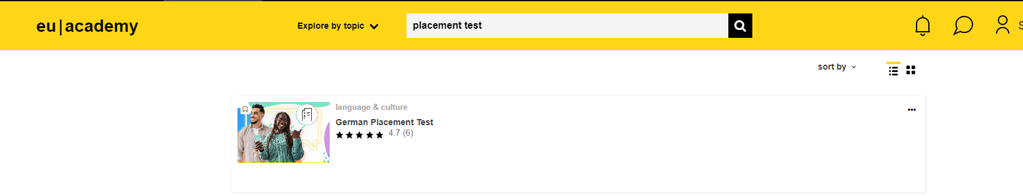
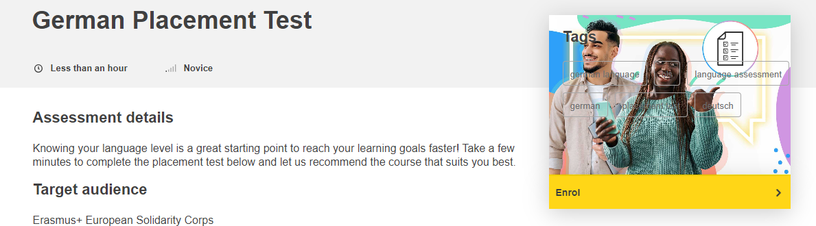
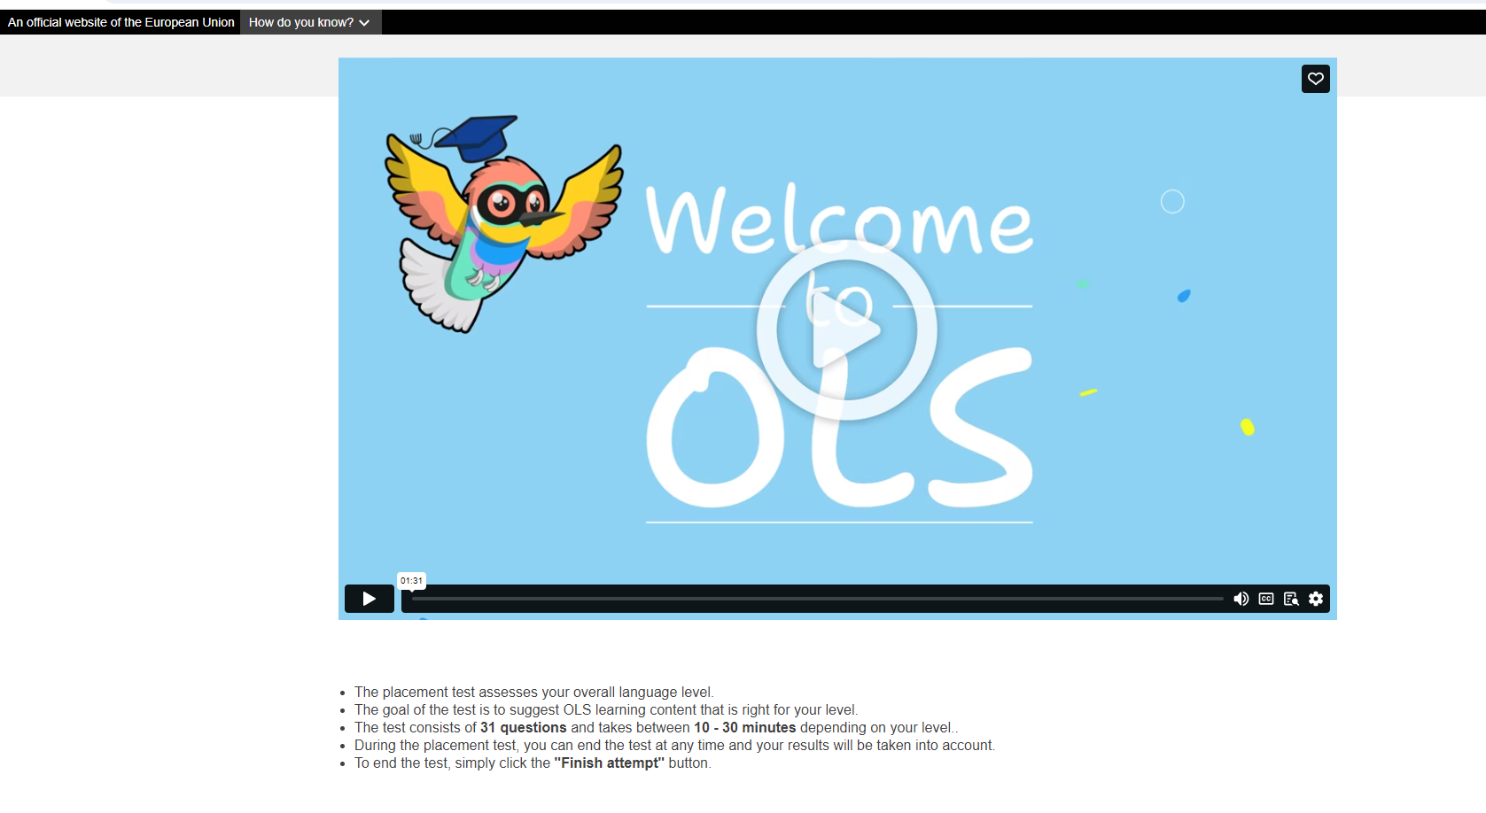
It's FREE!

Slide 33
DURING THE MOBILITY
Submit the arrival certificate by the first week after your arrival
If necessary, ask for a mobility extension: extension periods are not covered by the grant!

Slide 34
AFTER THE MOBILITY
MANDATORY for everyone:
Traineeship certificate
Final report
> forms on our website
Complete the final OLS test
EU Survey: sent to you via email
Deadline for submission:
For undegraduates: at least 45 days before graduation
For recent graduates: by 30 days after your return

Slide 35
IF YOU RETURN JUST BEFORE GRADUATING:
You must e-mail all return documents no later than 30 days before your graduation date!!

Slide 36
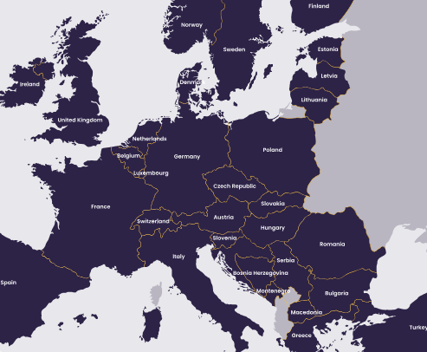
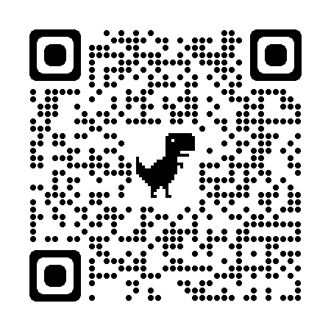
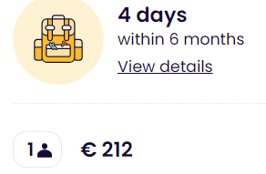
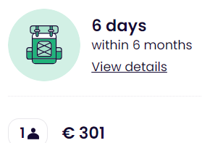
TRAVEL – INTERRAIL PASS for ERASMUS +
A train pass reserved for Erasmus students.
Non-European Erasmus+ participants must be residents in a European country.
It lasts 6 months. Within this period you can travel 4 or 6 days in up to 33 European countries – regional trains. For high speed and night trains, reservation is needed.
The pass allows up to 2 journeys in your home country: 1 to leave, 1 to return - at any stage of your Pass’ validity.

Slide 37
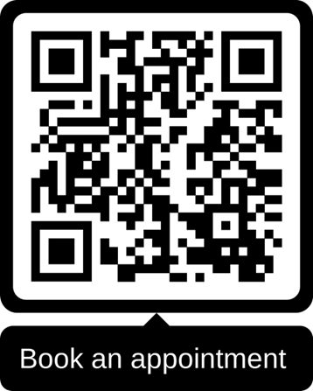
HOW TO GET IN TOUCH WITH US?
One-to-one meeting in a virtual room
One-to-one meeting in presence
Wednesdays from 13:30 to 15:00
Fridays from 10:00 to 11:30
(on appointment only)
Tuesdays from 9.00 a.m. to 12.00 p.m.
(on appointment only)
E-mail Contact HUB: outgoing.mobility@unipv.it
Erasmus+ for Study, Overseas Exchange Programme, Double Degrees, EC2U Alliance -
Notes:
15 mins time slot to answer all the questions related to the mobility or more general questions
The link to book is available

Slide 38
Thanks for your attention and…
Enjoy your mobility experience!

